Slide 1

SUBJECT CODE
TYPE THE SUBJECT NAME HERE
Fake Manipulation Detection In Social Network
DATE:15/04/2024
BATCH NUMBER : SEC25ITTE30169
PROJECT CODE : SEC25ITTE30169
BATCH MEMBER : Avinaash Venkat B(412521205025)
Dhakshin Vikash V(412521205035)
SUPERVISOR : Ms.THAMIZHSELVI D
III
VI
20ITTE501- INNOVATIVE DESIGN PROJECT

Slide 2

20ITPJ601
INNOVATIVE DESIGN PROJECT
PROBLEM STATEMENT
In the digital age, people often face the challenge of discerning between genuine and manipulated information, especially within the realm of social networks. The project directly tackles this problem by providing a robust solution for fake news detection and manipulation identification. Users can now navigate the social networking platform with increased confidence, knowing that a community-driven approach, facilitated by a polling mechanism and advanced detection algorithms, actively works to maintain the accuracy and reliability of shared information.
One prevalent issue in online spaces is the spread of misinformation, often causing confusion and eroding trust. This project offers a unique approach by turning users into active contributors to the verification process. The inclusion of a polling mechanism transforms manipulation. This not only addresses the problem of individual vulnerability to misinformation but also fosters a sense of shared responsibility, promoting a more resilient and trustworthy social network.
In the online environment, disengagement with news is a common challenge. The React JS-powered user interface not only simplifies information verification but also boosts user involvement. By creating a more intuitive and interactive platform, the project transforms verification from a solo task to a collaborative.

Slide 3
20ITPJ601
INNOVATIVE DESIGN PROJECT
ABSTRACT
The contemporary digital landscape faces the formidable challenge of combating fake news, misinformation, and manipulation. This project proposes a robust solution by developing an advanced system that combines sentiment analysis, machine learning, and manipulation detection algorithms to assess the authenticity and potential bias in news articles. The project employs a systematic approach, starting with collecting reliable data from reputable sources, followed by meticulous preprocessing to enhance the system's accuracy. The inclusion of an AI-based News app extends the project's capabilities to not only classify news as genuine or fake but also to identify potential manipulation techniques. The app provides users with a user-friendly interface for real-time analysis, delivering trustworthy information and promoting transparency. Model training incorporates labeled data to teach algorithms to discern patterns indicative of fake news and manipulation, ensuring a comprehensive understanding of the complexities involved. Thorough evaluation measures, including accuracy, precision, recall, and F1-score, validate the system's reliability and effectiveness. This holistic approach empowers users to make informed decisions by offering a trustworthy news source, free from manipulation and bias, thereby contributing to the integrity of information in the digital era.
KEYWORDS : ML,API,AI,PNA,CANARY(Content Authenticity Noted with AI for Reliable News),JSON,PAC.

Slide 4
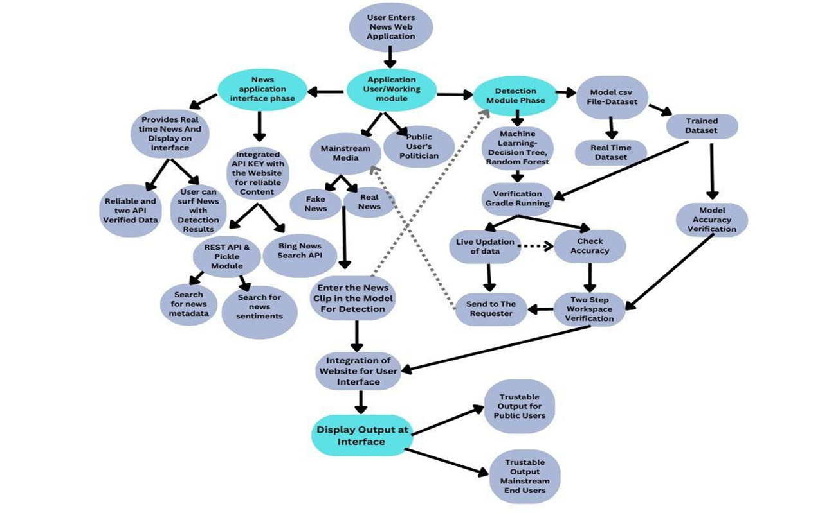
20ITPJ601
INNOVATIVE DESIGN PROJECT
SYSTEM ARCHITECTURE

Slide 5
MODULES
20ITPJ601
INNOVATIVE DESIGN PROJECT
Module 1: Data Fetching and analysis of dataset
● Data Retrieval
● Data Analysis and Preprocessing
Module 2: Retrieving the pickled data to the News web app using pickle
● Data Encryption
● Analysis of the Data from Dataset
● Python backend functioning over the Front End and showing the output
Module 3: Authentication of Data
● Data Integration Verification
● Polling Status generation
● Real Time News Generation

Slide 6
MODULES
20ITPJ601
INNOVATIVE DESIGN PROJECT
Module 4: Dataset Training and Dataset input
● Data set training on latest Events
● Data set training and storing the historical events through API.
Module 5: Deployment & Integration of AI News Interface
● Infrastructure Setup
● Real-time Data analysis
● Working Of AI Enhancement
Module 6:Integration of the User Data in Web Application For News Interface
● AI integrated Advanced News Application

Slide 7
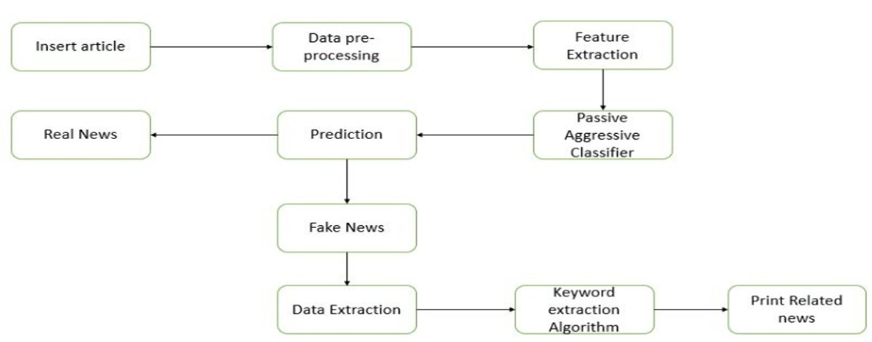
MODULES
20ITPJ601
INNOVATIVE DESIGN PROJECT
Module 1: Data Fetching and analysis of dataset
Data Retrieval: involves retrieving diverse and reliable data from APIs and credible sources. Python scripts handle the data processing, ensuring a clean and standardized dataset for subsequent analysis.
Data Analysis and Preprocessing: The module encompasses exploratory data analysis techniques to glean insights from the data, preparing it for machine learning models. Robust data retrieval and preprocessing are critical steps in establishing a foundation for effective sentiment analysis and image verification in subsequent modules. This initial phase sets the stage for creating a comprehensive and accurate fake news detection system.

Slide 8
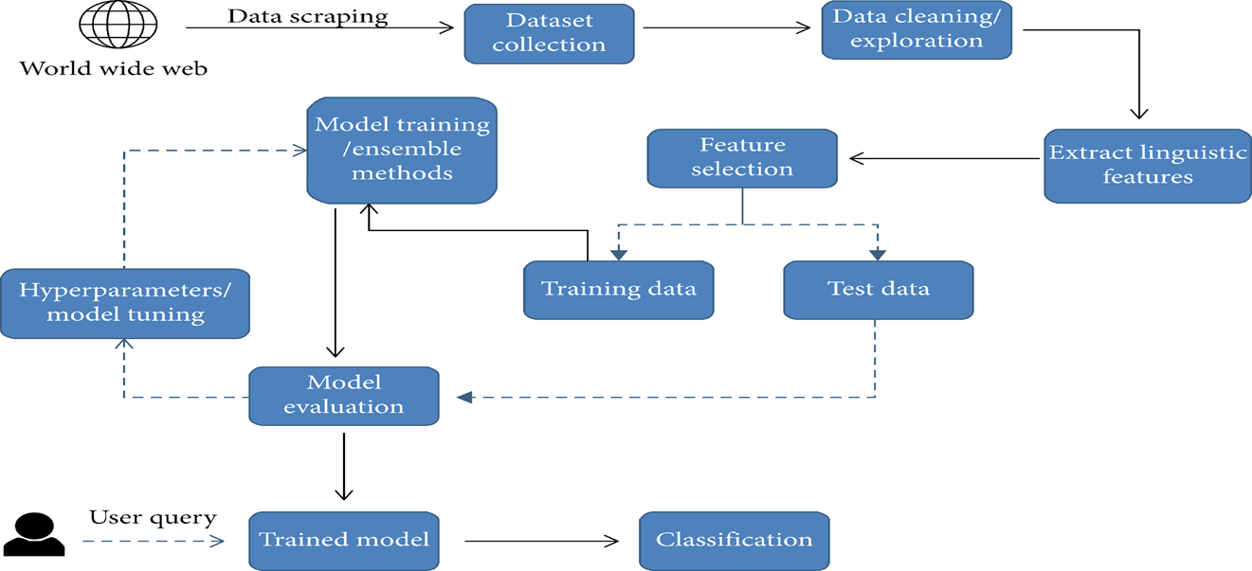
20ITPJ601
INNOVATIVE DESIGN PROJECT
Module 2: Retrieving the pickled data to the News web app using pickle
Data Encryption: Description: Implement robust encryption, like SSL/TLS protocols, to secure transaction data during transmission, enhancing protection against cyber threats.
Analysis of the Data from Dataset: Conduct thorough analysis using statistical methods and machine learning to extract insights, revealing patterns and anomalies within the dataset.
Python Backend Functioning over the Front End: Integrate Python backend seamlessly with the frontend for efficient communication, handling user reques

Slide 9
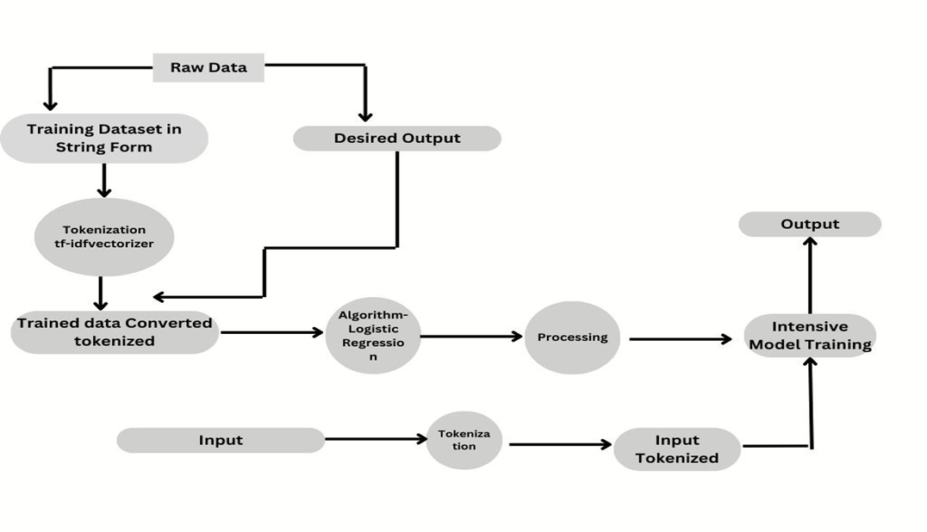
20ITPJ601
INNOVATIVE DESIGN PROJECT
Module 3: Authentication of Data
Data Integration Verification: Verify seamless data integration using validation checks, ensuring accuracy and reliability for subsequent analysis in the News web app.
Polling Status Generation: Generate real-time updates on polling status, fostering user engagement and transparency in the News web app community.
Real-Time News Generation: Dynamically presents the latest news updates, prioritizing breaking news and user preferences for a responsive user experience in the News web app.

Slide 10
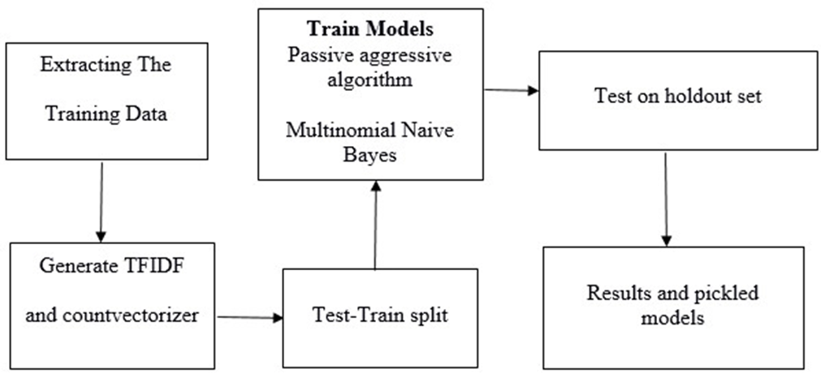
20ITPJ601
INNOVATIVE DESIGN PROJECT
Module 4:Dataset Training and Dataset Input
Data Set Training on Latest Events: Implement machine learning algorithms to train the dataset on the most recent events, ensuring the model is up-to-date with real-time information for accurate analysis within the News web app.
Data Set Training and Storing Historical Events through API: Conduct training on the dataset while simultaneously storing historical events via API integration. This dual approach enhances the model's capabilities, allowing it to analyze both current and past data for comprehensive insights in the News web app.

Slide 11
20ITPJ601
INNOVATIVE DESIGN PROJECT
Module 5: Deployment & Integration
Infrastructure Setup: Establish a robust infrastructure for the deployment of the AI News Interface, ensuring scalability and reliability in handling user requests within the News web app.
Real-time Data Analysis: Implement real-time data analysis capabilities within the AI News Interface, enabling swift processing and presentation of dynamic news content to users based on the latest information and trends.
Working of AI Enhancement: Showcase the functionality of AI enhancements in the News web app, highlighting how machine learning algorithms contribute to news readers.
Data Integration Verification: Verify seamless data integration using validation checks, ensuring accuracy and reliability for subsequent analysis in the News web app.
Polling Status Generation: Generate real-time updates on polling status, fostering user engagement and transparency in the News web app community.
Real-Time News Generation: Dynamically presents the latest news updates, prioritizing breaking news and user preferences for a responsive user experience in the News web app.

Slide 12
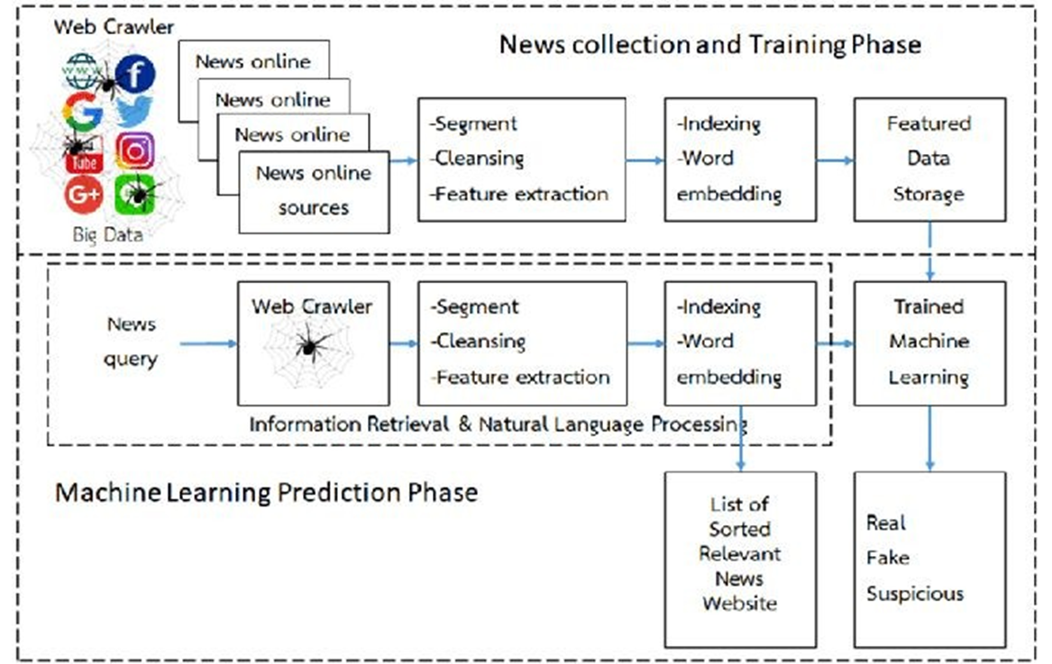



20ITPJ601
INNOVATIVE DESIGN PROJECT

Slide 13
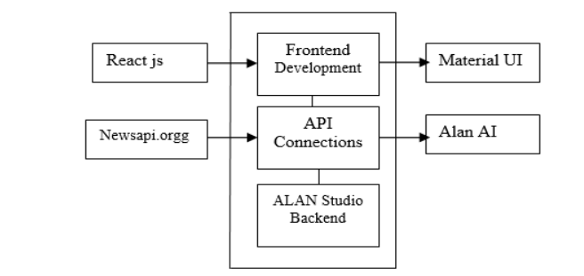
20ITPJ601
INNOVATIVE DESIGN PROJECT
Module 6:Integration of the User Data in Web Application For News Interface
AI integrated Advanced News Application

Slide 14
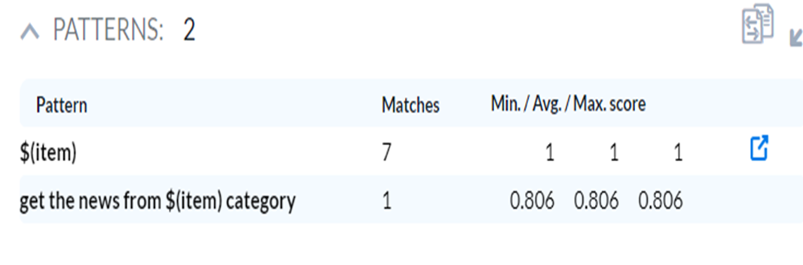
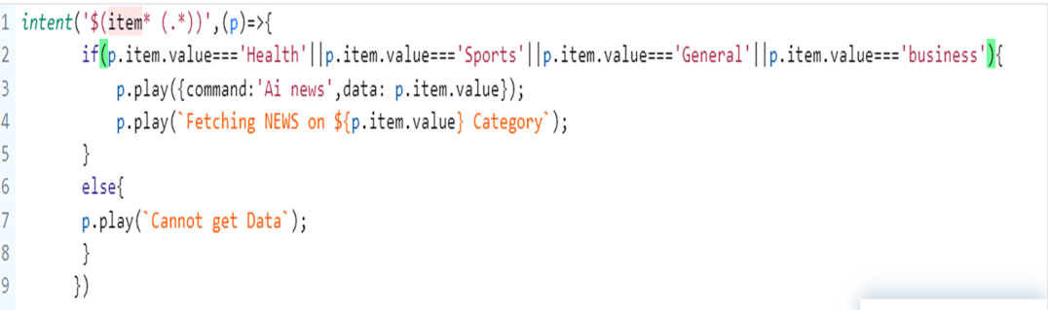
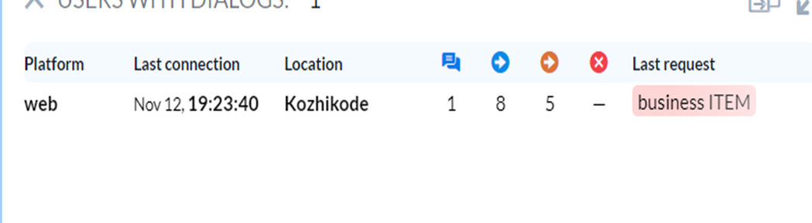
20ITPJ601
INNOVATIVE DESIGN PROJECT
PROTOTYPE DEVELOPMENT
i) API Component & Deployment
API Deployment and JSON Module

Slide 15
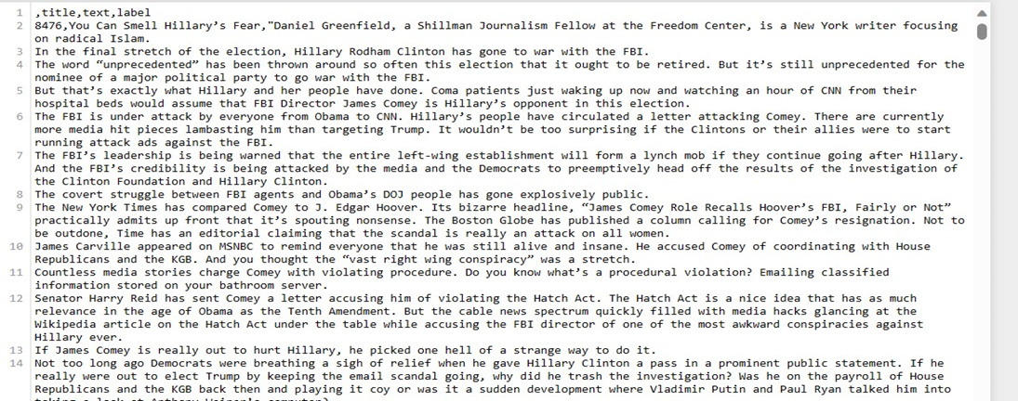
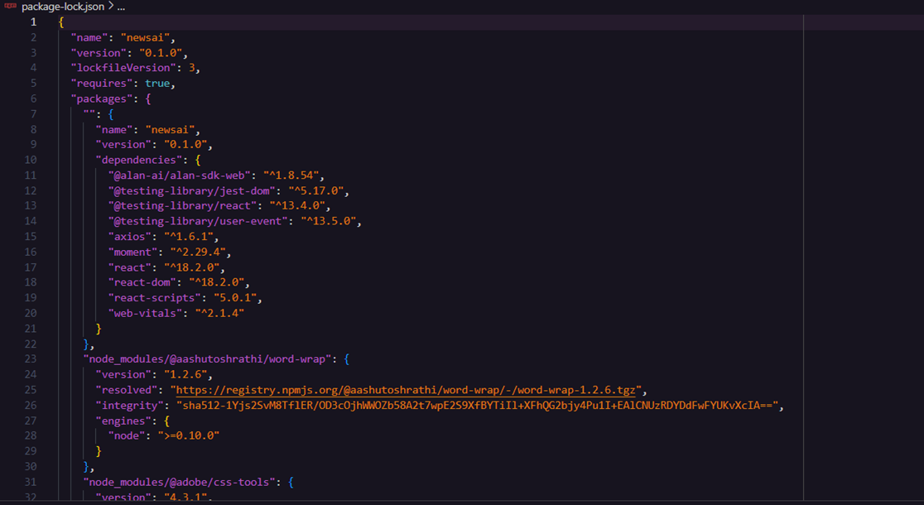
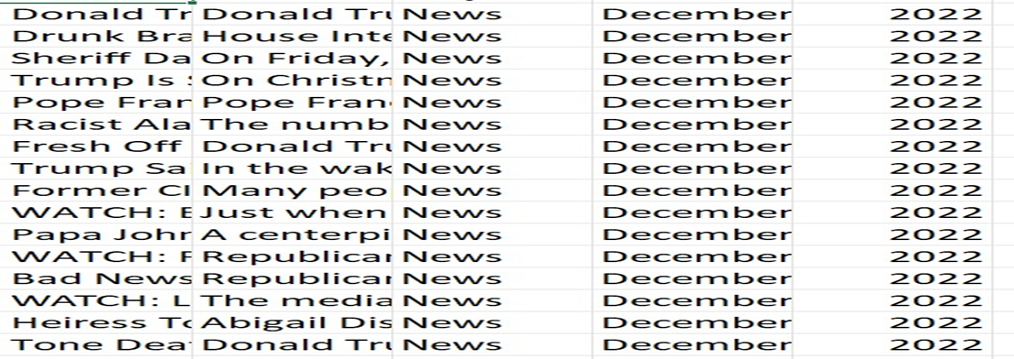
20ITPJ601
INNOVATIVE DESIGN PROJECT
PROTOTYPE DEVELOPMENT
i) Dataset
ii)API Integration
Features of Dataset
JSON Module For API Integration

Slide 16
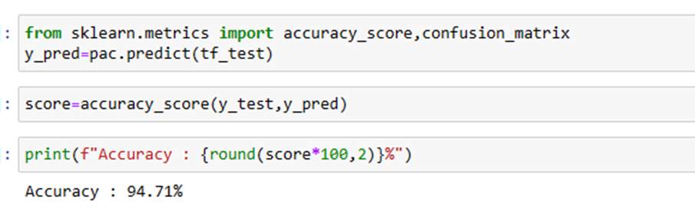
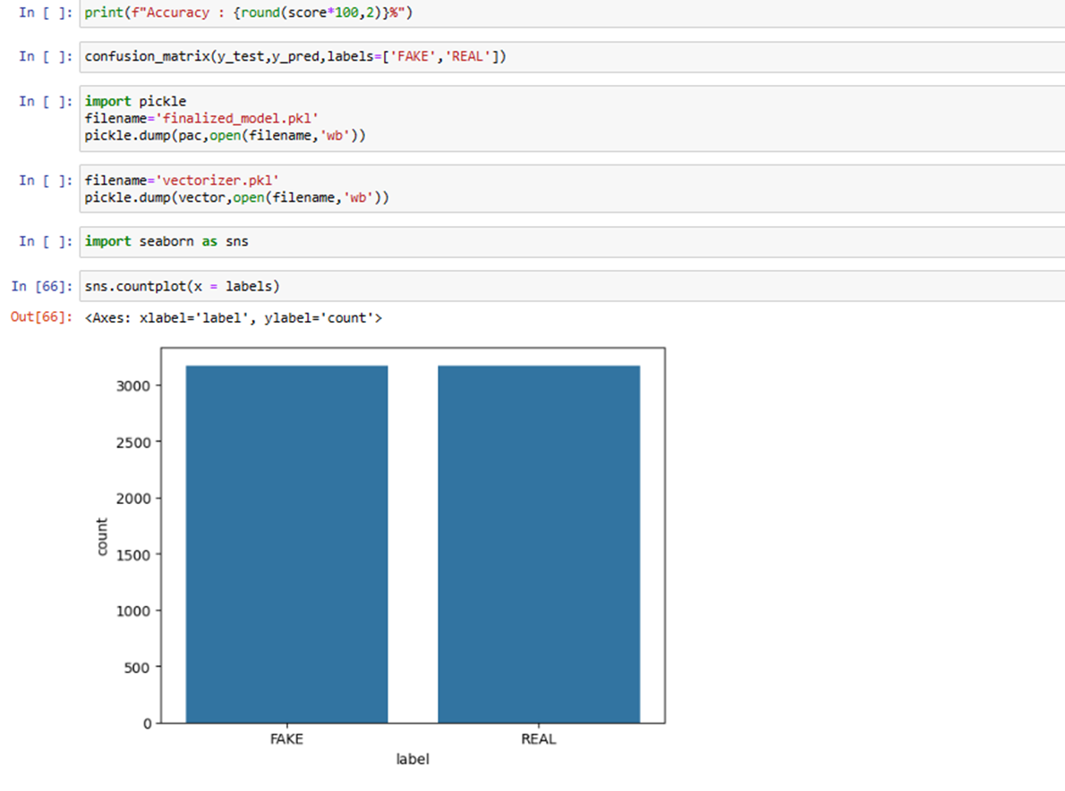
20ITPJ601
INNOVATIVE DESIGN PROJECT
PROTOTYPE DEVELOPMENT
iii) ML Sample Analysis
ML Result and Analysis

Slide 17

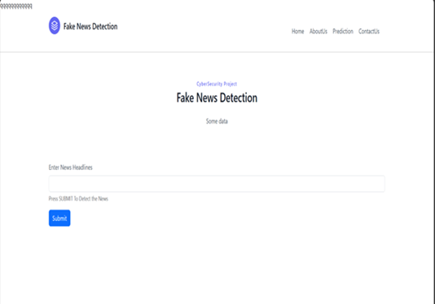
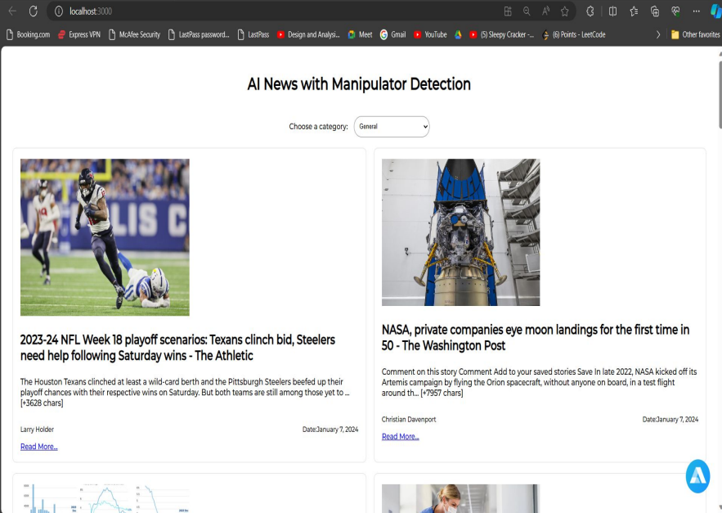
20ITPJ601
INNOVATIVE DESIGN PROJECT
PROTOTYPE DEVELOPMENT
iv) Website Module & Connection
v)AI integrated News application

Slide 18
20ITPJ601
INNOVATIVE DESIGN PROJECT
PROTOTYPE DEVELOPMENT
Flow of the Project
Data Fetching and Analysis of Dataset:
Retrieve diverse data from APIs, preprocess it for standardization, and pave the way for robust analysis. This foundational step ensures a comprehensive dataset for subsequent modules.
Transaction Data Encryption and API Integration:
Ensure the security of transaction data through encryption while seamlessly integrating APIs. This phase focuses on creating a secure and well-integrated environment within the News web app.
Real-Time News Generation:
Provide dynamic insights into community-driven verification processes through real-time polling status updates. Simultaneously, dynamically generate and present real-time news updates, prioritizing breaking news and user preferences for a responsive user experience

Slide 19
20ITPJ601
INNOVATIVE DESIGN PROJECT
PROTOTYPE DEVELOPMENT
Addition of Feature:
Continuously evolve the News web app by integrating new features based on user feedback and emerging trends. This ensures that the News web app remains innovative, user-centric, and adaptable to evolving user needs.
User Interface and Interaction:
Implement a user-friendly interface that allows users to seamlessly input news articles, participate in polls, and explore personalized content. The interface serves as an intuitive platform for users to engage with real-time news updates, enhancing their overall experience within the News web app

Slide 20
FUTURE ENHANCEMENT
20ITPJ601
INNOVATIVE DESIGN PROJECT
Looking forward, our project envisions comprehensive enhancements that extend beyond the detection of fake news to include a sophisticated focus on fake image detection and deep face recognition. By integrating advanced image analysis techniques, the system aims to identify manipulated and morphed images, adding a crucial layer to its capabilities. In the realm of deep fake detection, future iterations will explore cutting-edge algorithms and deep learning models to enhance the system's ability to discern artificially generated content. This evolution is crucial in the face of emerging challenges associated with deep fake technologies, ensuring that our project stays ahead in its commitment to information accuracy and integrity. These enhancements will not only fortify the platform against manipulated textual content but also offer a robust defense against the manipulation of visual elements. By incorporating state-of-the-art image and deep fake detection technologies, our project strives to provide users with a comprehensive solution, fostering a digital space where both textual and visual information can be verified and trusted.

Slide 21
CONCLUSION
20ITPJ601
INNOVATIVE DESIGN PROJECT
At its core, our initiative stands as a front-runner in addressing the intricate challenges prevalent in our digital society, particularly focusing on detecting manipulated content. In a global landscape grappling with the pervasive spread of misinformation, digital disparities, and mounting privacy concerns, the profound significance of our commitment to a robust solution cannot be overstated. Leveraging advanced machine learning algorithms, sentiment analysis, and rigorous data processing, our system meticulously distinguishes between authentic and manipulated information. The overarching goal is to empower the public against the detrimental impact of fake news, playing a pivotal role in restoring trust within the digital information sphere. Beyond being merely a technological endeavor, our project embodies an unwavering dedication to transparency, inclusivity, and the revitalization of trust in the digital realm. By providing a dependable platform that empowers users to authenticate information, we anticipate a societal transformation toward a discerning, well-informed, and interconnected community. Navigating the intricate dynamics of the digital age, our project serves as a guiding force, envisioning a future where information is not only a source of empowerment but a beacon for truth, fostering a society where individuals confidently engage in a shared, well-informed discourse for collective advancement

